Slide 1
The Political Economy of Global Equity
Warwick International Development Summit
Molly Scott Cato
Reader in Green Economics, Cardiff School of Management
Green Party Economics Speaker

Slide 2
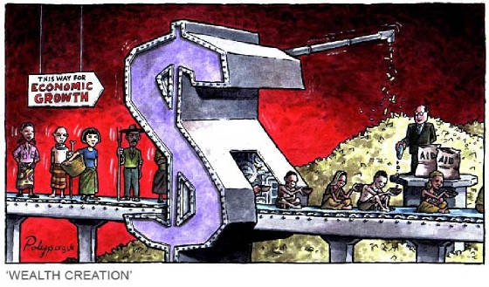
Environmental Crisis: Who causes; who suffers?

Slide 3
Comparisons of annual consumption
 | USA | Europe | China | India | Africa | World
Cars | 750 | 240 | 7 | 6 | 9 | 91
Fuel | 1624 | 286 | 33 | 9 | 36 | 174
Energy | 8520 | 3546 | 896 | 515 | 580 | 1640
Meat | 125 | 74 | 52 | 5 | 13 | 40
Water | 430 | 159 | 135 | 174 | 47 | 173
Popn. | 293 | 730 | 1306 | 1080 | 887 | 6500
Children | 2.08 | 1.56 | 1.72 | 2.78 | 4.82 | 2.55
Data for 2004/5 from Pretty, J. (2007), The Earth Only Endures: On Reconnecting with Nature and our Place in it (London: Earthscan).

Slide 4
Emissions per capita for a range of countries in 2007 (tonnes of CO₂ per capita)
Source: UN Statistics Division

Slide 5
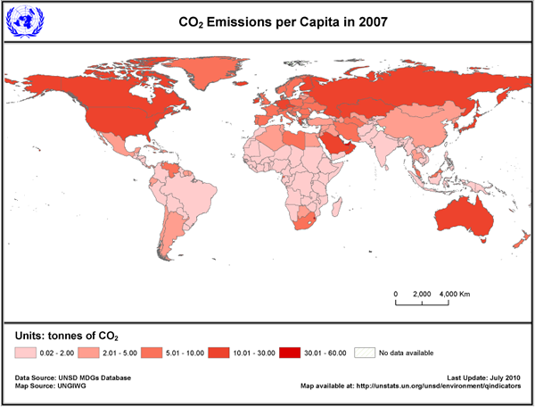
CO₂ Emissions Per Capita

Slide 6
Carbon dioxide emissions per capita, 1990-2007
 | 1990 | 2000 | 2004 | 2007
Burundi | 0.03 | 0.04 | 0.03 | 0.02
Cambodia | 0.05 | 0.04 | 0.03 | 0.31
Nigeria | 0.48 | 0.72 | 0.83 | 0.64
India | 0.79 | 1.1 | 1.2 | 1.4
Brazil | 1.4 | 1.9 | 1.8 | 1.9
China | 2.1 | 2.7 | 3.8 | 4.9
France | 6.4 | 6.0 | 6.2 | 6.5
UK | 10.1 | 9.9 | 9.8 | 8.97
Saudi | 15.7 | 13.1 | 13.4 | 16.3
USA | 18.8 | 20.9 | 20.4 | 19.7

Slide 7
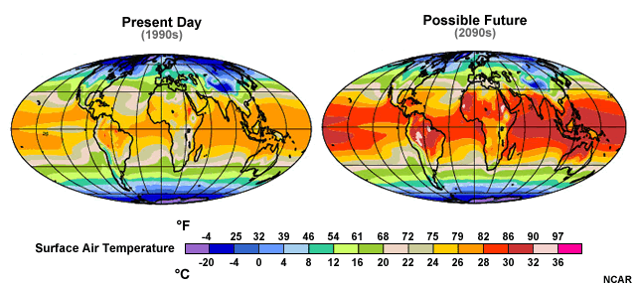
Warming is worse nearer the equator
Notes:
Global average temperatures are expected to increase by about 2-13°F (1-7°C) by the end of the century. That may not sound like a lot, so what’s the big deal? The problem is that small changes in global average temperature can lead to really large changes in the environment. Let’s look at some of the expected changes.

Slide 8
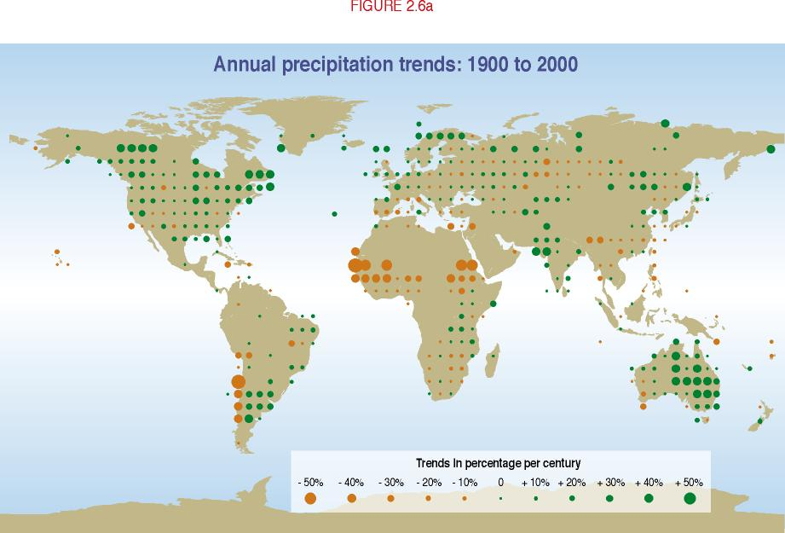
Precipitation patterns have changed

Slide 9
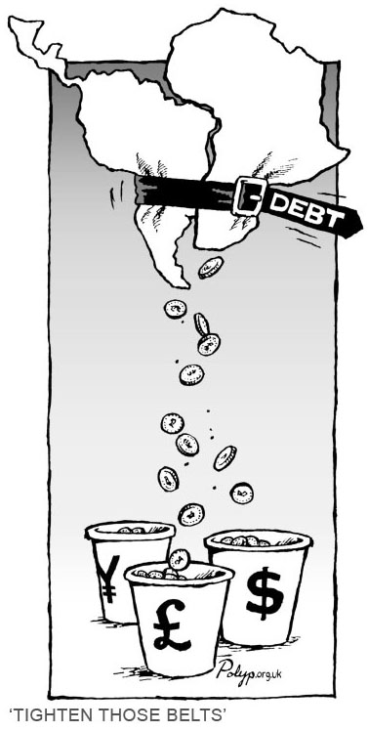
Understanding global financial power

Slide 10
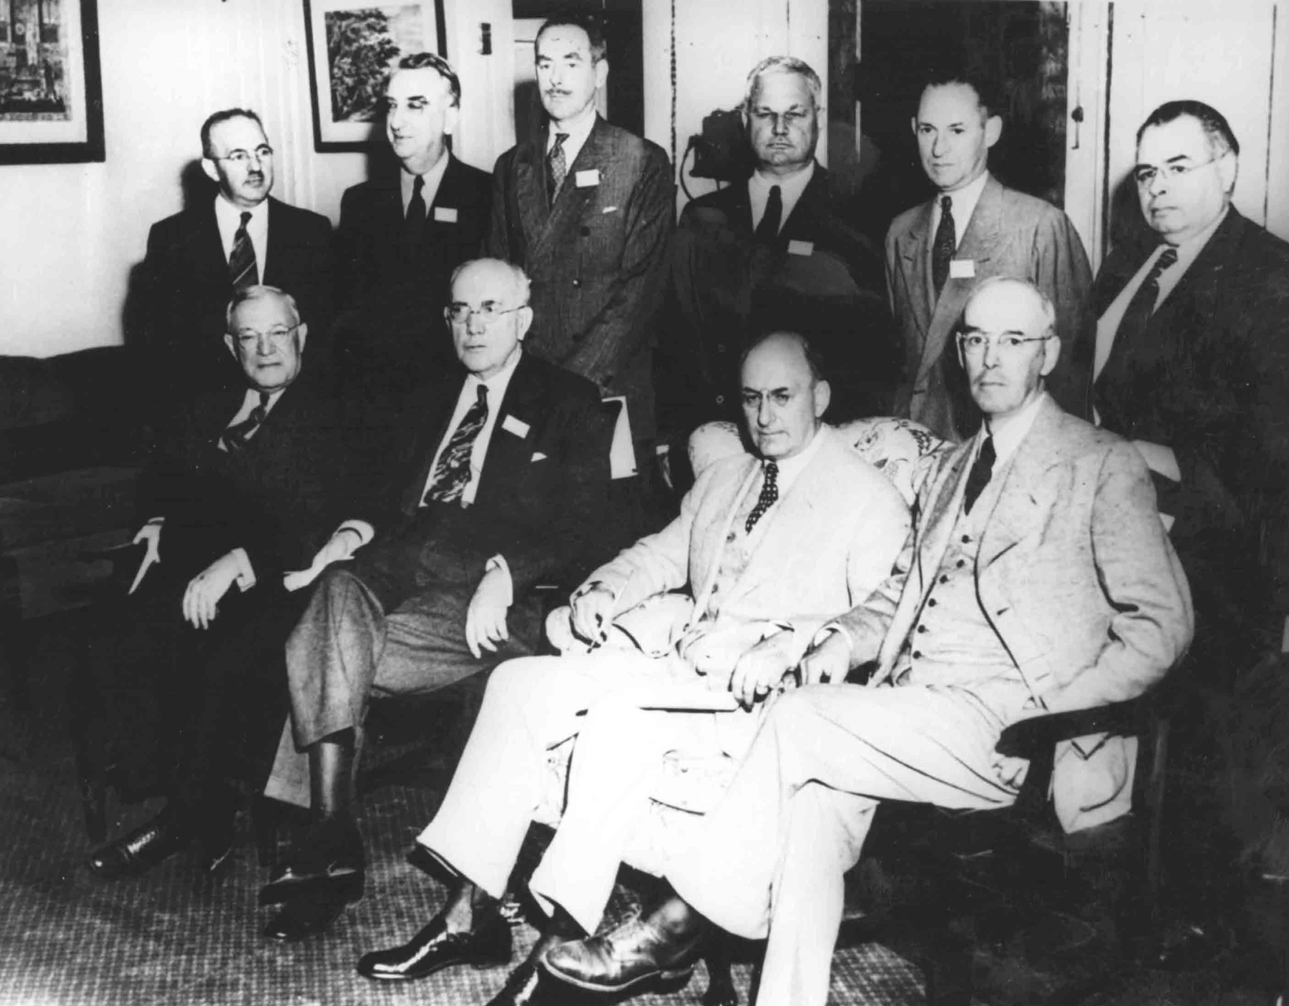
The world according to . . .

Slide 11
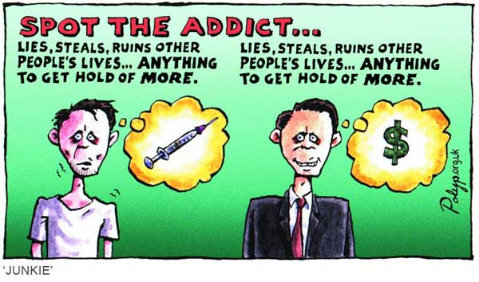
Money and globalisation
The finance industry lies at the heart of globalisation. Of the total international transactions of a trillion or so dollars each day. 95 per cent are purely financial. Globalisation in not about trade; it is about money.
the financial system now completely dominates the real economy of goods and services
Mellor et al. The Politics of Money (2002)

Slide 12
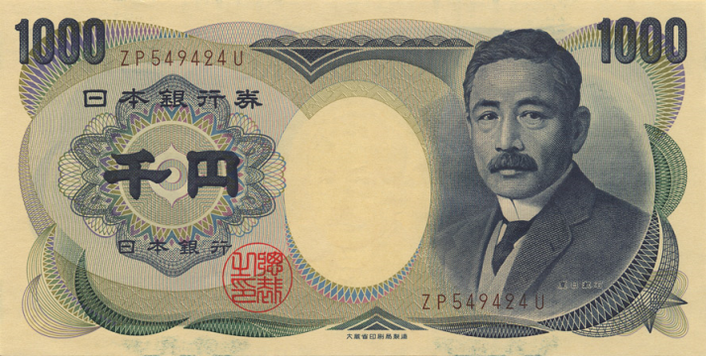
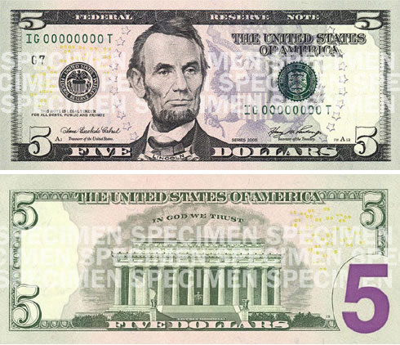
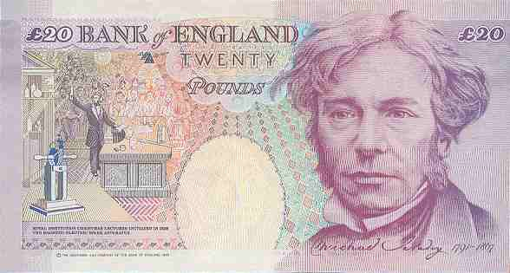
Reserve currencies
Reserves necessary to guarantee foreign trade and settle external balances
Around 70% of world reserves held in dollars
20-30% held in euros
Around 3% held in sterling; 2% in yen

Slide 13
Who runs the IMF?
Country | Quota (m. SDRs) | Votes (%)
China | 8,090 | 3.65
Czech Republic | 8,443 | 0.38
France | 10,738 | 4.85
Germany | 13,008 | 5.87
India | 4,158 | 1.88
Italy | 7,055 | 3.19
Japan | 13,312 | 6.01
Russia | 5,945 | 2.69
Saudia Arabia | 6,985 | 3.16
United Kingdom | 10,738 | 4.85
United States | 37,149 | 16.74
Rest of world |  | 33.79

Slide 15
What the IMF is for
Trade requires an exchange of currency
A corporation would rather be paid in a reserve currency
So the importer country wants to have dollars or euros in its banks to pay for imported goods and services
The IMF was set up to lend countries these reserves so that they could continue to trade
It also collects information about member countries and publishes reports
It also offers technical advice

Slide 16
The message from the IMF
Privatise—get the state out of the economy
Liberalise—open the economy up to global markets in goods and capital
Stabilise—balance the budget by cutting public spending and increasing taxation: Structural Adjustment Program

Slide 17
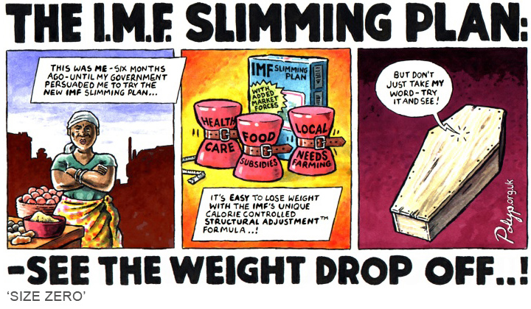

Slide 18
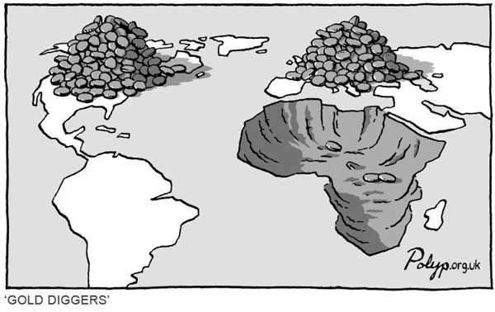
Neocolonialism
Continued control over a disproportionate share of the world’s resources
‘Formalizing dominance’, through the global financial institutions (Peet, 2008)
Continuation through ‘great land grab’ and commodification of ‘eco-system services’

Slide 19
New ‘Financial Architecture’
1. World Bank: which would be responsible for managing a neutral environment-backed currency unit (ebcu) and regulating international trade
2. International Carbon Clearing House: which would be responsible for the issuing of carbon permits monitoring of CO2 emissions.
3. General Agreement on Sustainable Trade: which would monitor global trade to ensure balance between nations and that the trade could be justified within a low-carbon framework.

Slide 20
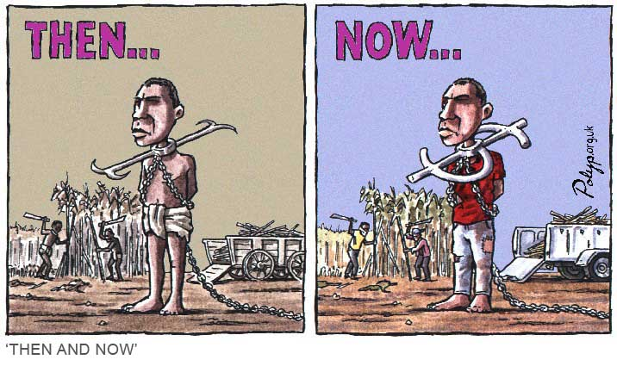
Can Trade Help to Make Poverty History?

Slide 21
The consequences for the poor
Changes in Terms of Trade, 1980-2 to 2001-3
Group | Annual average 1980-2 | Annual average 2001-3 | % change
Developed economies | 95.7 | 103.3 | +7.9
Developing economies | 117.3 | 97.7 | -16.7
Developing economies | 131.7 | 100.0 | -24.1
Least developed countries | 144.0 | 93.3 | -35.2
Landlocked countries | 114.7 | 96.3 | -16.0
Sub-Saharan Africa | 124.0 | 98.3 | -20.7
Data from UNCTAD; calculations in Tom Lines, Making Poverty: A History (2008).

Slide 22
The critique of the three Cs
Competition between poor countries
Control: the WTO is heavily politically dominated
Climate change

Slide 23
General Agreement on Sustainable Trade
Support the local | Governments allowed to favour domestic production
Favouring certain partners | States will be allowed to choose to give preferential trade terms to goods and services from other states which respect human rights, treat workers fairly, and protect the environment
Performance requirements | States may impose requirements on corporations opening production facilities in their territories based on: a minimum level of domestic input to the production process; a minimum level of local equity investment; a minimum level of local staff; minimum environmental standards
Standstill and rollback | No state party to GAST can pass laws or adopt regulations that diminish local control of industry and services
Dispute resolution | Citizen groups and community institutions should be able to sue companies for violations of this trade code, under a transparent and public process.

Slide 24
Trade subsidiarity
Local, non-intensive goods such as seasonal fruit and vegetables and other raw materials which can be grown without much complex labour input.
Global, non-intensive goods, which do not need much labour but require a different climate from our own.
Local, complex goods that require skill and time to produce but not the import of raw materials.
Global, complex goods that need technical expertise and considerable time to produce and for which raw materials or the size of market suggests a problem with local production.

Slide 25
Production possibility grid
Labour |  | Raw materials
 |  | Local | Global
 | Non-intensive | Farmers’ markets; self-build; domestic textiles | Fair trade; replace WTO with GAST
 | Intensive | Support of local craft workers | Mending to replace obsolescence; end to intellectual property laws

Slide 26
Sufficiency economy
A watchword of sustainable economics is self-reliance—not self-sufficiency, which I believe holds very few attractions. Self-reliance entails combining judicious and necessary trade with other countries with an unapologetic emphasis on each country maintaining security of supply in terms of energy, food and even manufacturing.

Slide 27
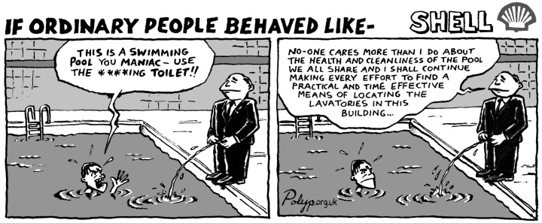
Commodification and the Carbon Trade

Slide 28
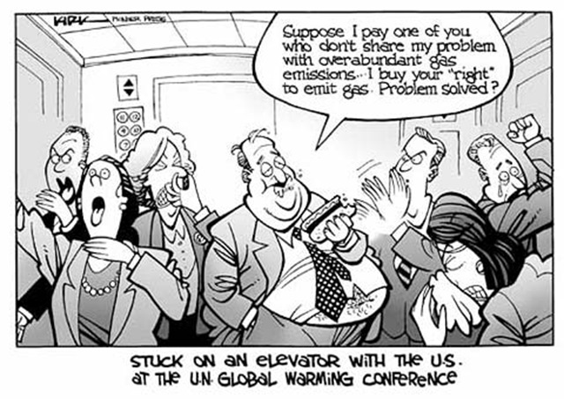
Problems with the carbon trade
The ‘product is politically defined’
Market already dominated by a small number of players and subject to marginal trading in derivatives
Leading to commodification of ‘eco-system services’ and great land grab

Slide 29
Contraction and Convergence

Slide 30
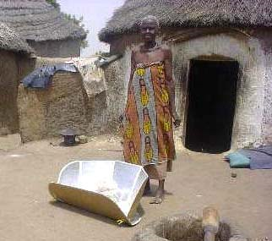
Converging World
25 per cent of the profits from the electricity generated by wind turbines directed to support partner communities
transfer of intermediate technology

Slide 31
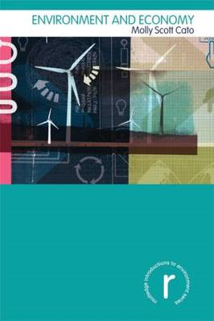
Find out more
www.greeneconomist.org
gaianeconomics.blogspot.com
Green Economics: An
Introduction to Theory, Policy
and Practice (Earthscan, 2009)
Environment and Economy
(Routledge, 2011)

